Slide 1
NUCL 402 Report: Fast Reactor Core Design
A look at the History of Fast Reactor Design, Focusing on that done by the DOE especially at Argonne National Laboratory
Kevin Fischer || Alex Hagen || Neal Kostry

Slide 2
Introduction (Neal)
Assumed: making 2-3 slides for each topic (more if pictures). Gives us from 18-27 slides, so 45-60 seconds spent on each topic gives us a 20 minute presentation.

Slide 3
History of Fast Reactors
Neal

Slide 4
CP-1

Slide 5
CP-3 (EBR-1)

Slide 6
ZPR

Slide 7
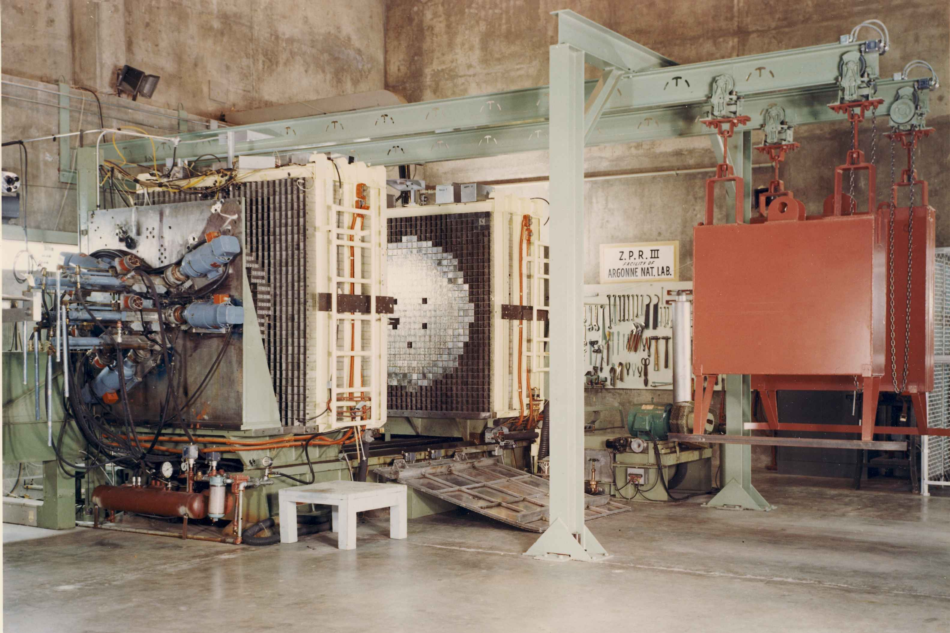
ZPR

Slide 8
Technical Specifications
Alex

Slide 9
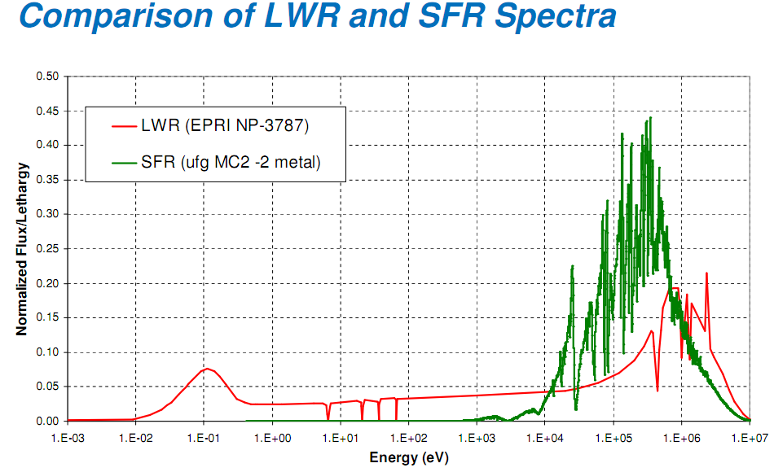
Fuel Design and Moderator
Spectra causes need for different fuel, coolant, building materials
Few Thermal Neutrons
No Moderation Needed
Resonances in Fast region Important
Fast Neutrons causes need for geometric change
Fast neutrons have longer range
Leakage will be higher
Leakage > Res Absorption
Causes large design shift away from moderation

Slide 10
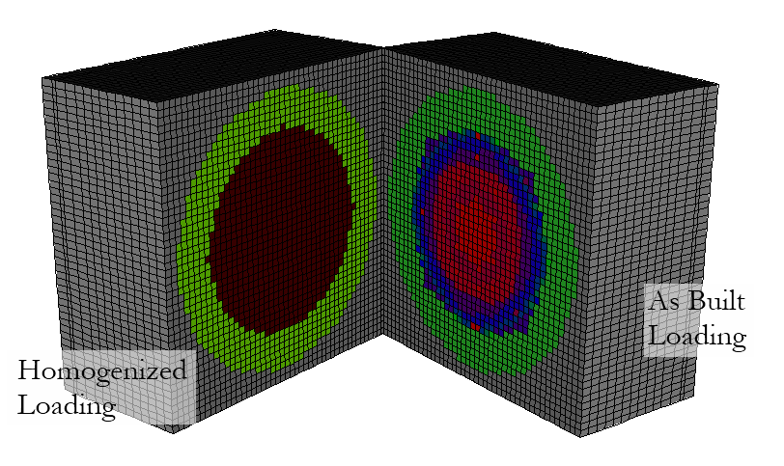
Reactor Design (Research)

Slide 11
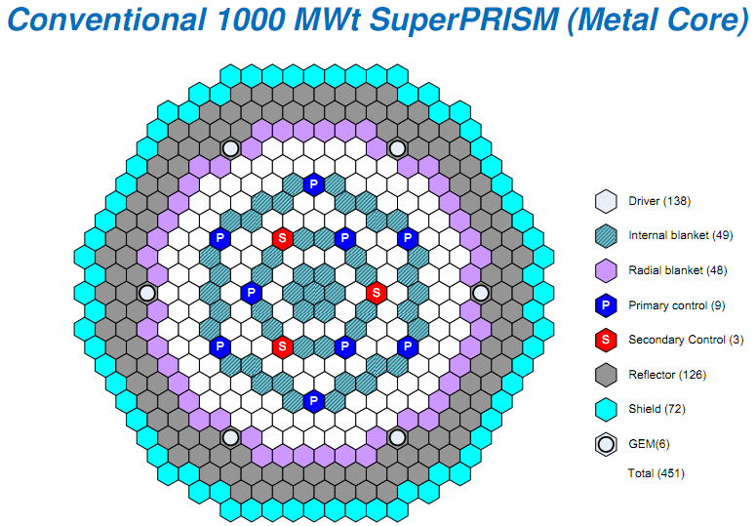
Reactor Design (Power)

Slide 12
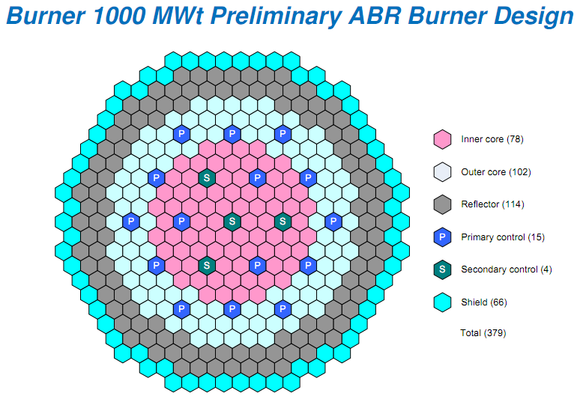
Reactor Design (Power)

Slide 13
Optimization Considerations
Little to No Moderation
Slowing Down Power ~1% of LWR Slowing Down Power
Sodium Coolant used despite physical difficulties for less moderation
Oxide fuels provide moderation even though better thermal properties
Resonance Absorptions within non-fissile materials
Pu vs. U Fuels (ZPPR21)
Reflectors
Borated Shield, Outer Blanket, (Depleted U) Reflector

Slide 14
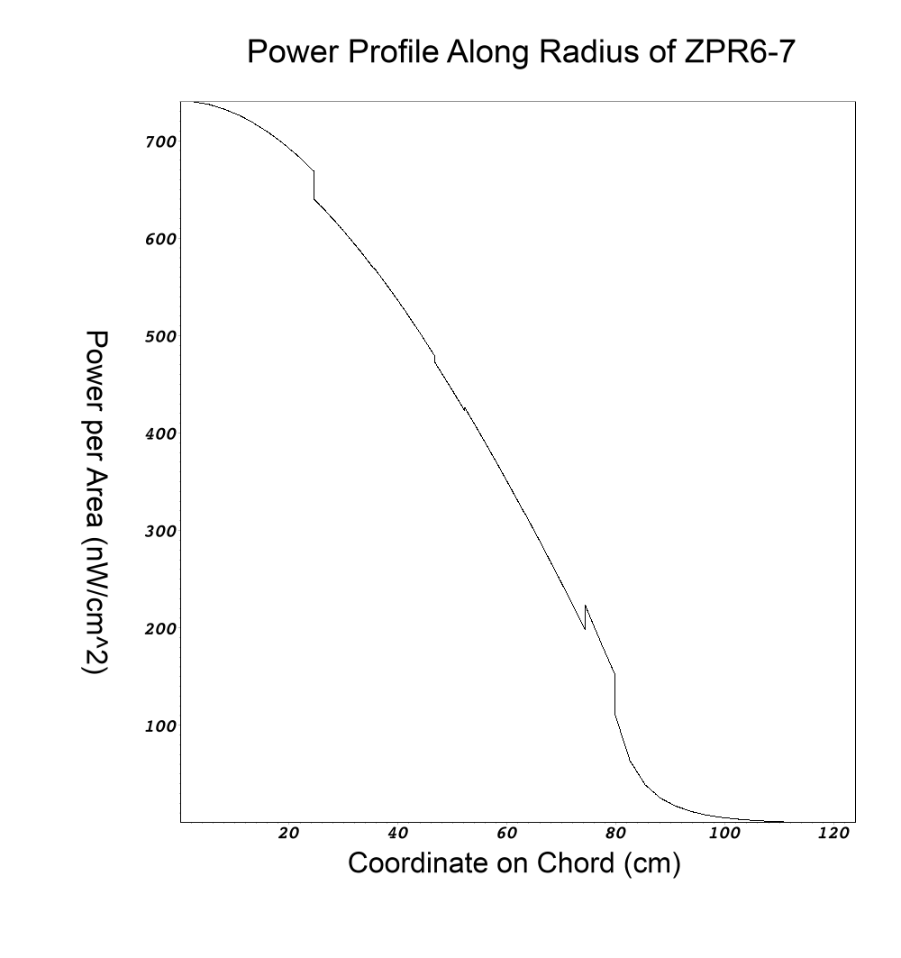
Power Profiles (No Control Rods)
Cosine (at criticality) function within core
Immediate dropoff at borated shield
Fast decrease through blanket
Increase at reflector, same rate decrease,
Dropoff to zero during gap region, protection of operating facility
NO CONTROL RODS IN MODEL

Slide 15
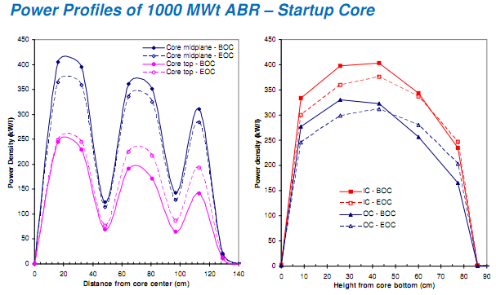
Power Profiles (Power Reactor)

Slide 16
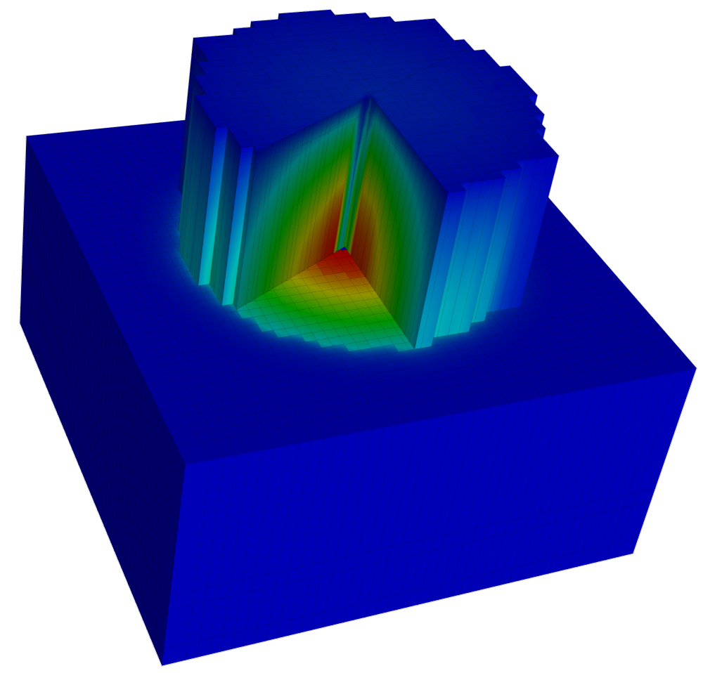
Power Profiles (3-D Research)
3-D Cutaway of ZPR6-7 Reactor
Gap Material (Blue) has been removed from top half
Cutaway into core shows color map of power distribution in 3 dimensions
Fission chamber in center (shows low power in chamber)
NO CONTROL RODS IN MODEL

Slide 17
Applications and Future Uses
Kevin

Slide 18
Applciations in Current Reactors

Slide 19
Safety Systems

Slide 20
Breeder Reactors

Slide 21
References

Slide 22
Questions?

Slide 23
Additions Slides

